Slide 1
A Seminar Presentation
on
PIEZO ELECTRICITY
Submitted By
E.VINODH
(10BF1A0214)
Under the Esteemed Guidance
MUNISEKHAR, M.tech…
Assistant Professor(SL)
DEPARTMENT OF ELECTRICAL AND ELECTRONICS ENGINEERING
SRI VEKATESWARA COLLEGE OF ENGINEERING
KARAKAMBADI ROAD, TIRUPATI
(2010-14)

Slide 2

Contents:-
Abstract
Introduction
Generation of Electricity from Piezo Materials
Practical Implementation
Applications
Advantages
Disadvantages
Conclusion

Slide 3
Objective:-
In India
Installed Capacity : 223.343 GW as of March 2013.
Fifth Largest Place in Installation Capacity
&
Fourth Largest place in Consumption
This paper will gives information on one of the Renewable Resources which helps us to reduce the demand by supplying at least 5 to 10% of the demand supply.

Slide 4
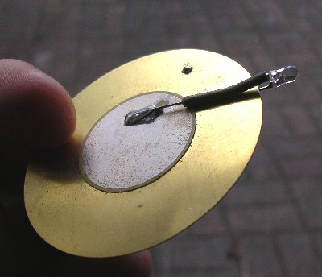
Introduction:-
The word “Piezoelectricity” comes from the Greek word “Piezin” which means “to press” or “squeeze”.
Because of the Quartz’s properties which allow it to generate electricity by pressure as well as mechanical distortion under voltage it is named as “Piezoelectricity”
In this piezoelectric materials there is a free movement of ions so that when some pressure is applied it produces some voltage across it.

Slide 5
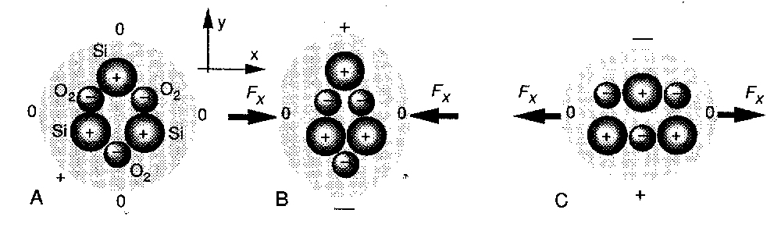
Generation:-
No pressure is Applied
Forward Pressure is Applied
Reverse Pressure is Applied

Slide 6
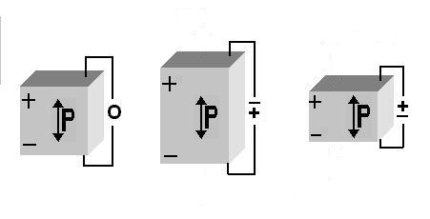
Generation:-
3 Dimensional View
No pressure is Applied
Reverse Pressure
is Applied
Forward Pressure is Applied

Slide 7
Generation:-
Animated View
Force
Piezo Electric Material
Force

Slide 8


Generation From Different Sources:-
Piezo electric pad
From High Ways

Slide 9
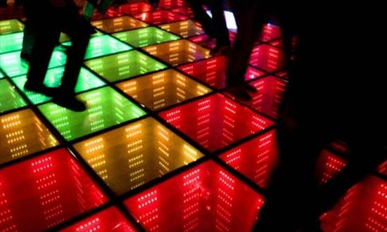
Contd…….
Discotheques
From Walking Floors

Slide 10
Applications:-
Piezo Sensors
Piezo Resistors
MEMS
Electric cigarette lighter
Medicals, Chemical and biological sensors
Music Instruments
Piezoelectric silicon devices
Automotive application,
Push –button grill starters etc.

Slide 11
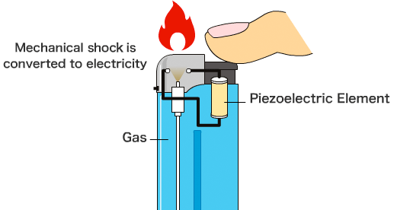
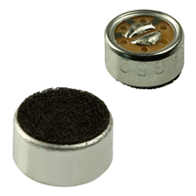

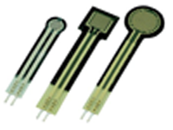

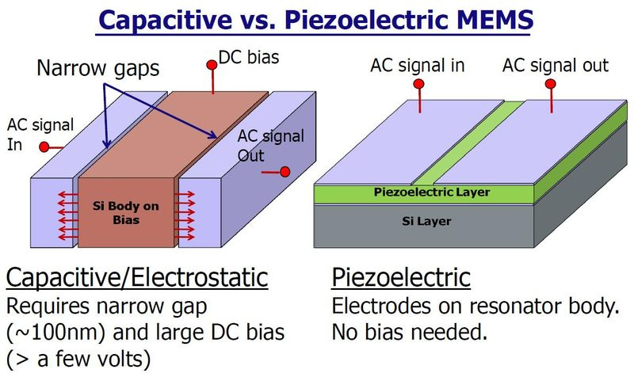
Contd…….
Piezo
microphones
Piezo
Buzzer
Piezo Sensors
Electric Cigarette Lighters
Touch Screen
MEMS

Slide 12
Practical Implementation :-
In Tokyo Train Station they are generating Electricity by installing the Piezoelectric pads at the ticket area (Courtesy Japan Railways Group).
The East Japan Railway Company (JR East) conducted a demonstration about this Piezoelectricity and is implemented at Yaesu North Gate, Tokyo Station, as a new power- generating floor. Installed at the ticket gate area, it generates electricity from the vibrations created by passengers walking through the ticket gates.

Slide 13
Advantages :-
Ecofriendly
Almost free of Noise
Wide frequency range, high frequencies can be measured
Compact yet highly sensitive
No moving parts – long service life
No external power required
Great variety of models available for nearly any purpose
Pollution free
It is a Renewable Energy resource

Slide 14
Disadvantages :-
Efficiency is less
Brittle due to crystalline structure
Cannot withstand high shear and tension can become
depolarized
Large stresses
Inverters has to use to convert D.C to A.C
More number of Piezoelectric materials are required

Slide 15
Conclusion:-
As the day to day population is increasing, there is a shortage of power and a large amount of pollution from generating stations. So that there is a need to go for Renewable energy sources like Air, water, sun etc.
Like wise this Piezo electricity is one of the renewable energy resource with many advantages like reliable, noise less ,easy to generate.
Hope India will soon implement this Piezo electricity concept, so that we can reduce the demand which in turn increases our economy.

Slide 16

Any Queries?????

